Slide 1
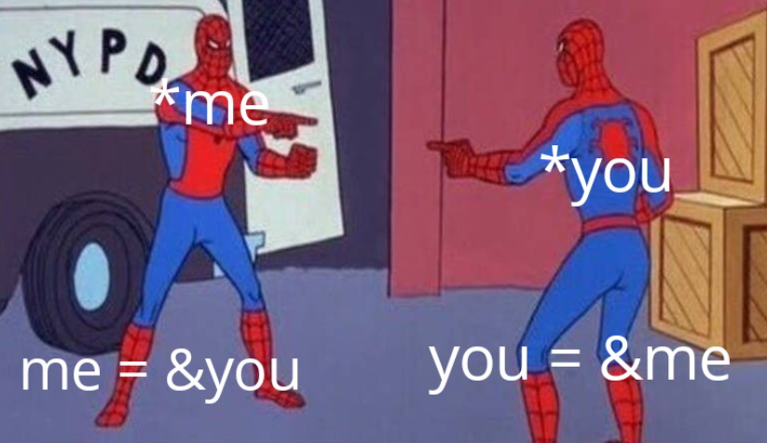
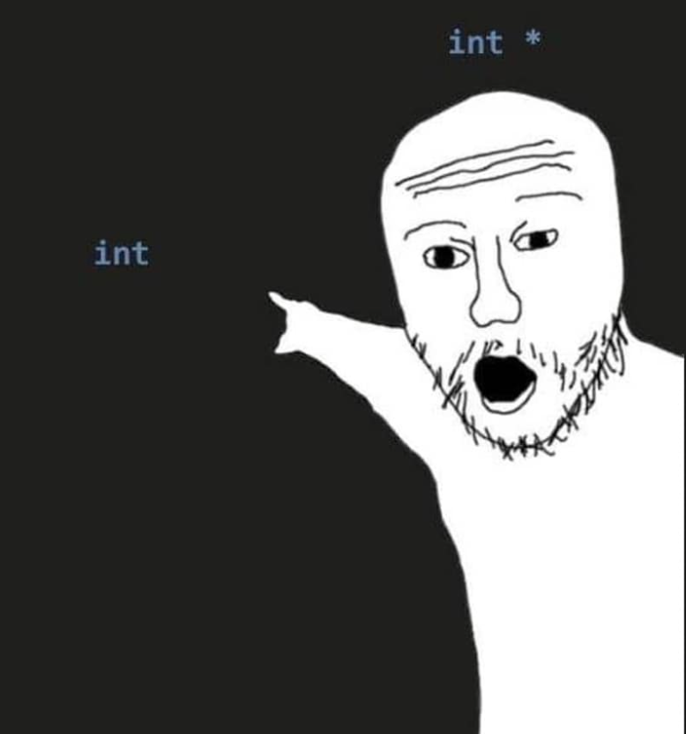
POINTERS
Week 14
Sumaiyah Zahid

Slide 2

Address Space
Name = FAST
Value / Occupants = Students
Address = St-4, Sector 17-D، National Hwy 5, Karachi

Slide 3
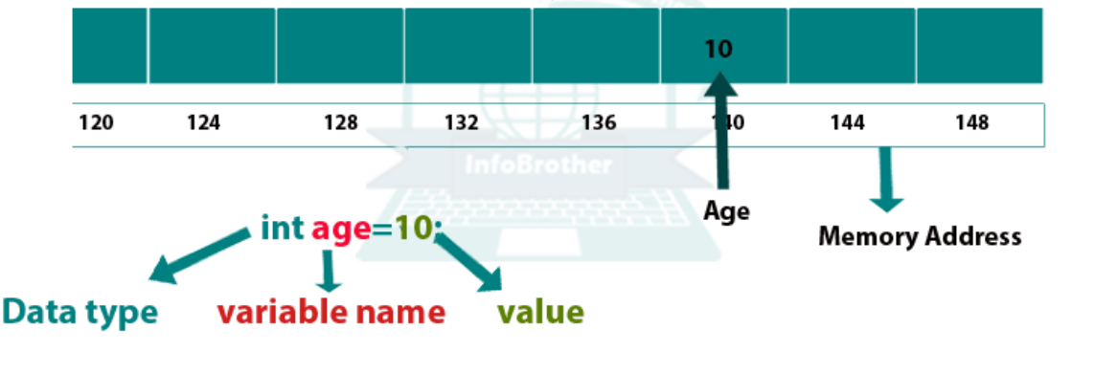
Address Space
int x = 10;
Name = x
Value = 10
Address = Any memory location
You can access that memory location using & operator.

Slide 4
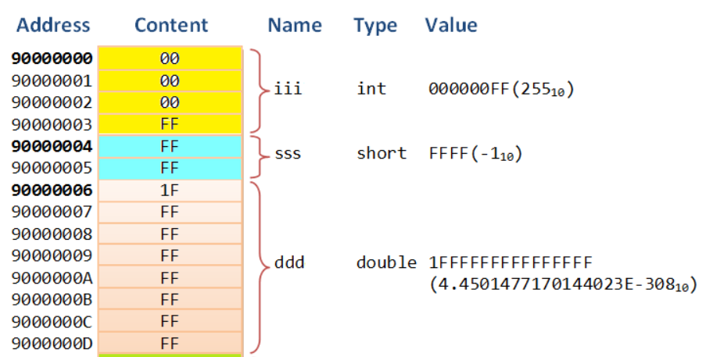
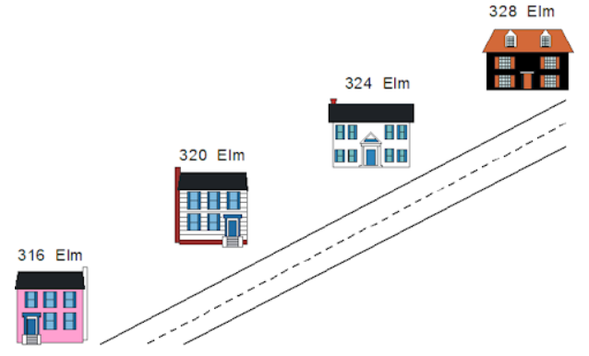
Address Space
Like houses, each variable has a unique address that gets larger as you move along the street or through memory.
The contents of a variable, like the occupants of a house, can change over time, but the address of a variable, like the address of a house, is fixed and does not change (unless the house is picked up by a tornado and carried over a rainbow, which almost never happens).

Slide 5
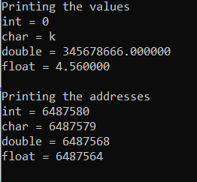
#include <stdio.h>
int main()
{
int a=0;
char b='k';
double c=345678666;
float d=4.56;
printf("Printing the values\n");
printf("int = %d\nchar = %c\ndouble = %lf\nfloat = %f\n",a,b,c,d);
printf("Printing the addresses\n");
printf("int = %d\nchar = %d\ndouble = %d\nfloat = %d \n", &a, &b, &c, &d);
return 0;
}

Slide 6
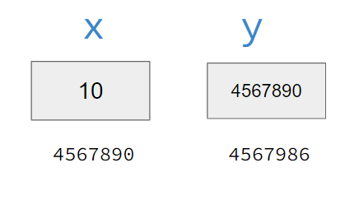
POINTERS DEFINITION
To hold any address of variable, computer needs another storage location.
Pointer is a variable which holds address of another variable.
int x = 10;
int *y = &x;

Slide 7
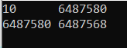
POINTERS DEFINITION
& Address Operator
* Dereferencing Operator
int x = 10;
int *y = &x; or int *y; y = &x;
printf("%d %d\n",x,y);
printf("%d %d\n", &x, &y);

Slide 8
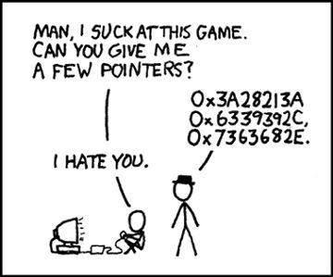
POINTERS DEFINITION
Interestingly we can access value of x through y variable too.
y = holds the address of x
*y = pointer accessing value
of x
printf("%d %d\n",y,*y);

Slide 9
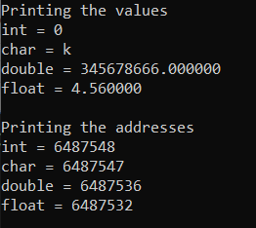
#include <stdio.h>
int main()
{
int a=0; int *ap;
char b='k'; char *bp;
double c=345678666;double *cp;
float d=4.56; float *dp;
ap = &a; bp = &b; cp = &c; dp=&d;
printf("Printing the values\n");
printf("int = %d\nchar = %c\ndouble = %lf\nfloat = %f\n", *ap, *bp, *cp, *dp);
printf("Printing the addresses\n");
printf("int = %d\nchar = %d\ndouble = %d\nfloat = %d \n", ap, bp, cp, dp);
return 0;
}

Slide 10
Why POinters?
Increases the execution speed of program.
Used for dynamic memory allocation.
Pass by reference.
Pointers makes possible to return more than one value in functions.
To access variables that are declared outside the functions.
Strings and arrays are more efficient with pointers.

Slide 11
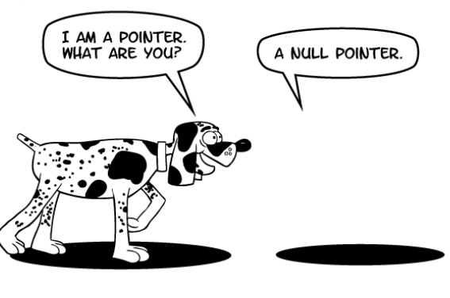
NULL Pointer
"I points nothing"
int *p= NULL;

Slide 12
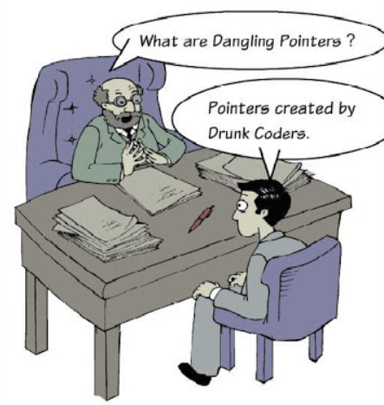
DANGLING POINTER
A pointer pointing to a memory location that has been deleted (or freed) is called dangling pointer.
Sometimes the programmer fails to initialize the pointer with a valid address, then this type of initialized pointer is known as a dangling pointer in C.

Slide 13

Pointers Practice
float num1 = 5.3;
float *ptr1 = &num1; float *ptr2 = ptr1;
printf("%0.1f, %0.1f\n", *ptr1, *ptr2);
float num2 = 7.6; ptr2 = &num2;
printf("%0.1f\n", *ptr1 + *ptr2);
float *ptr3 = ptr1;
*ptr1 = 2.2; *ptr2 = *ptr3; *ptr1 = 1.1;
printf("%0.1f, %0.1f, %0.1f\n", *ptr1, *ptr2, *ptr3);
ptr1 = ptr2; ptr2 = ptr3; *ptr1 = 7;
printf("%0.1f, %0.1f, %0.1f\n", *ptr1, *ptr2, *ptr3);

Slide 14
Pointers Arithmetic
int x = 10;
int *y = &x, *z;
*y = 5;
*y = *y + 10;
++*y;
(*y)++;
z = y;
++z; // pointer increment
z = z + 10;

Slide 15
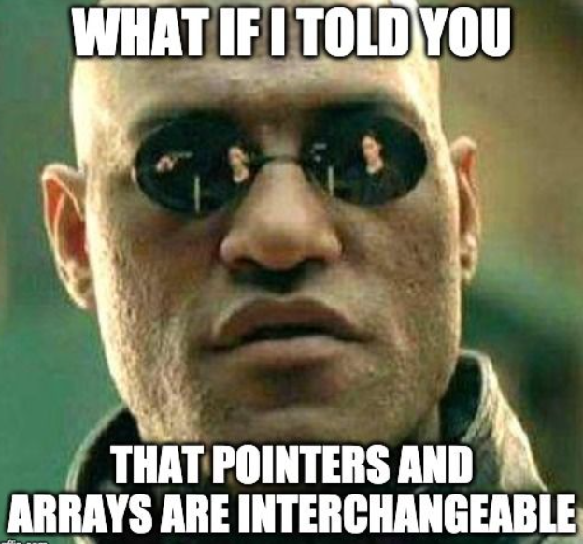
Arrays As a Pointers
int marks[]={90,86,89,76,91};
printf(“%d”, marks[2]);
printf(“%d”, marks); ????
Array name holds the starting address of that array i.e.
marks = & (marks[0])
Arrays are not variables, but pointer-variable.

Slide 16
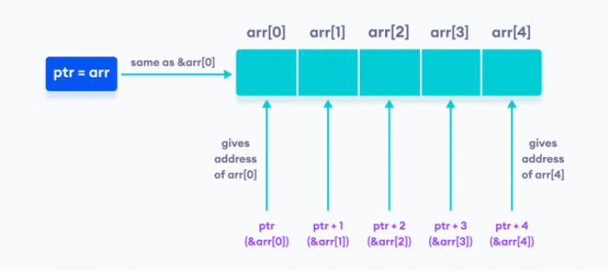
Arrays As a Pointers
int arr[]={90,86,89,76,91};
int *ptr=arr;
ptr = arr
arr = &arr[0]
arr[0] = *(arr +0) or *(ptr +0) // Array indexing is actually
arr[1] = *(arr +1) or *(ptr +1) //dereferencing memory location
arr[i] = *(arr +i) or *(ptr +i) //with pointer addition

Slide 17
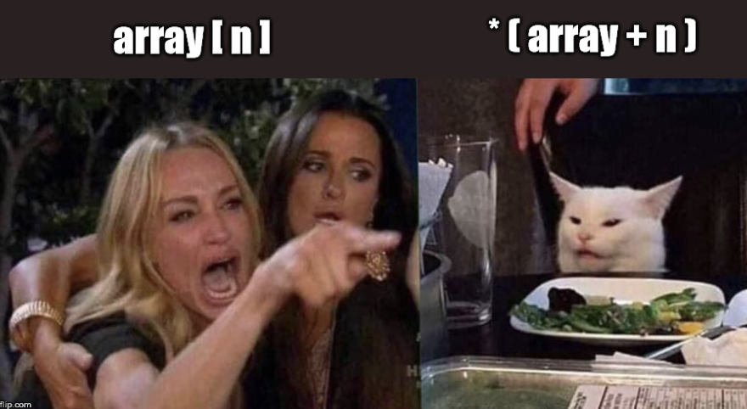
Arrays As a Pointers
#include <stdio.h>
int main()
{
int num[ ] = { 24, 34, 12, 44, 56, 17 } ;
int i, *j ;
j = num;
for ( i = 0 ; i <= 5 ; i++ )
{
printf ( "\naddress = %u ", j ) ;
printf ( "element = %d", *j ) ;
j++ ; /* increment pointer to point to next location */
}
}

Slide 18
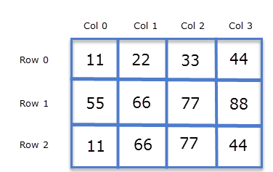
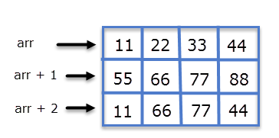
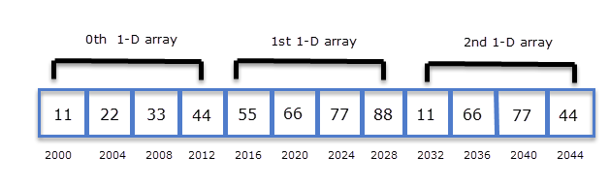
2D Array
https://overiq.com/c-programming-101/pointers-and-2-d-arrays/

Slide 19
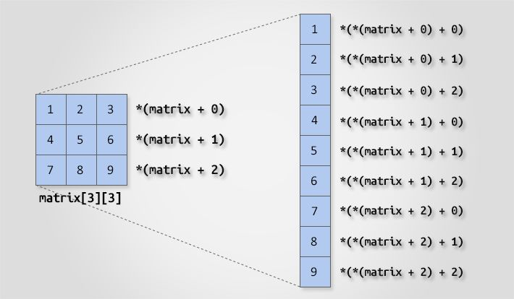
2D Arrays As a Pointers

Slide 20
Home Assignment
Make a c program to print 2D matrix using pointers.

Slide 21
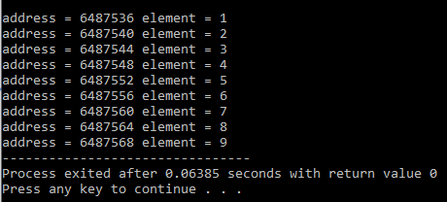
2D Arrays As a Pointers
#include <stdio.h>
int main()
{
int num[3][3] = { {1,2,3},{4,5,6},{7,8,9}} ;
int i, j;
for ( i = 0 ; i < 3 ; i++ )
{
for(j=0; j<3; j++)
{
printf ( "\naddress = %u ", *(num + i)+j ) ;
printf ( "element = %d", *(*(num + i)+j) ) ;
}
}
}

Slide 22
Arrays Practice Problem
Write a program that calculates the sum of all the elements in 1D and 2D array using pointers.
Write a program that finds the highest number in a float type array of 20 elements using pointer.

Slide 23
Strings As a Pointers
char name[ ] = "FAST" ;
char *ptr ;
ptr = name ; /* store base address of string */
while ( *ptr != `\0' )
{
printf ( "%c", *ptr ) ;
ptr++ ;
}

Slide 24
Strings As a Pointers
char str[ ] = "Hello" ;
char *p = "Hello" ;
We cannot assign a string to another, whereas, we can assign a char pointer to another char pointer.
Once a string has been defined it cannot be initialized to another set of characters. Unlike strings, such an operation is perfectly valid with char pointers.

Slide 25
Strings As a Pointers
char str1[ ] = "Hello" ;
char str2[10] ;
char *s = "Good Morning" ;
char *q ;
str2 = str1 ; /* error */
q = s ; /* works */
_____________________________
char str1[ ] = "Hello" ;
char *p = "Hello" ;
str1 = "Bye" ; /* error */
p = "Bye" ; /* works */

Slide 26
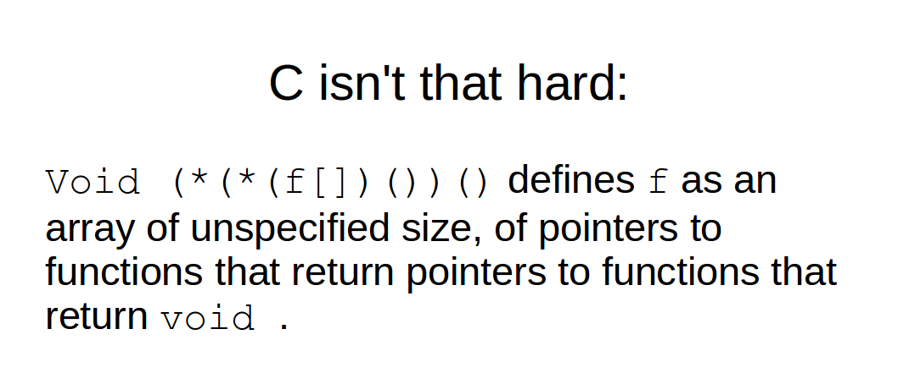
Functions & Pointers

Slide 27
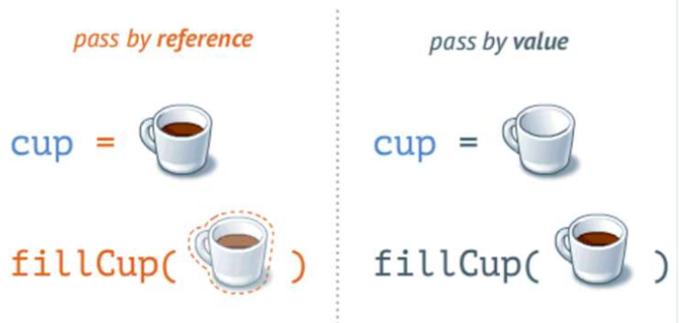
Calling Functions
Call by value
Copy of argument passed to function
Changes in function do not affect original
Use when function does not need to modify argument
Avoids accidental changes
All the examples mentioned before are using call by value.
Call by reference (We will study later with Pointers)
Passes original argument
Changes in function effect original
Only used with trusted functions

Slide 28
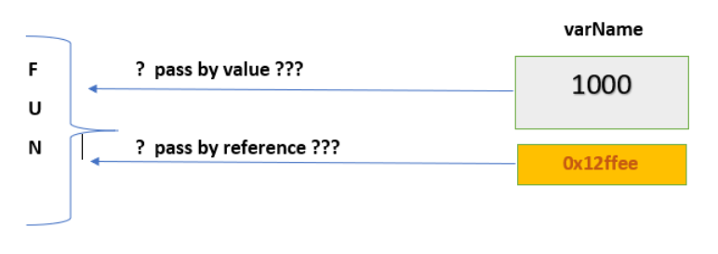
Pass By Reference
void function( int *p);
int *p,num=6;
p = &num;
function( p );

Slide 29
#include <stdio.h>
int cube(int *a);
int main()
{
int num=4, *p;
p=&num;
cube(p); // cube(&num);
printf("%d", num);
return 0;
}
int cube(int *a) // a is an alias or nickname of p
{
*a= (*a) * (*a) *(*a);
}

Slide 30
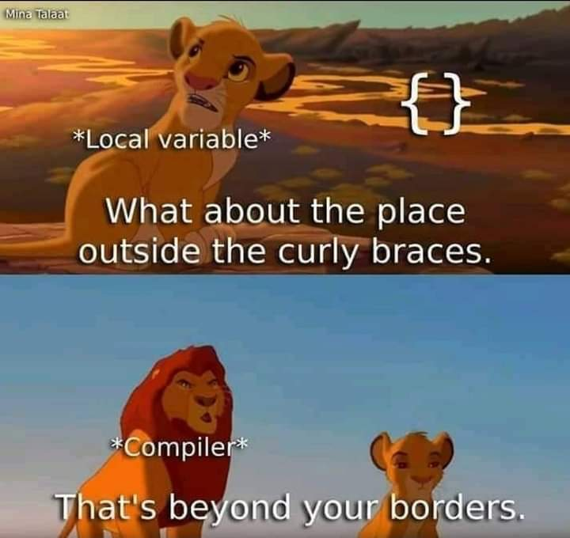
Returning A Pointer
int *function();
int *ptr;
ptr=function();
Never return a pointer to local variable from a function.
Local variable exists only inside the function and as soon as function ends the variable cease to exists. Even though the address returned by the function is assigned to ptr inside main(), the variable to which ptr points is no longer available. On dereference the ptr you will get some garbage value.

Slide 31
Returning A Pointer
Static variables have a property of preserving their value even after they are out of their scope!
Static variables help local variables to exist even when the function ends.
There is an always ocean of knowledge which depends how deep you want to dive.
https://www.geeksforgeeks.org/static-variables-in-c/

Slide 32
#include <stdio.h>
int * cube(int a);
int main()
{
int num=4, *p;
p= cube(num);
printf("%d", *p);
return 0;
}
int * cube(int a)
{
static int x=0;
x= a*a*a;
return &x;
}

Slide 33
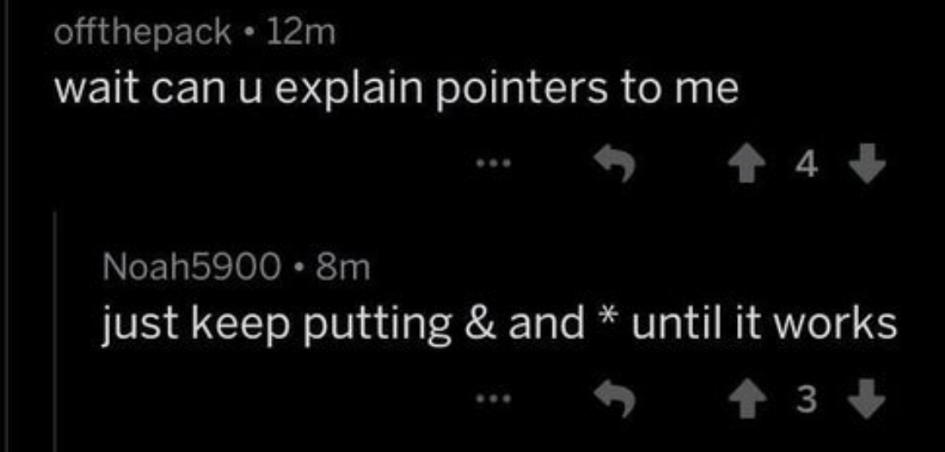
Passing Arrays By Reference
Array name is already a pointer, so passing an array name is itself passing by reference.
That means, if you update array element in function, it also changes in main.

Slide 34
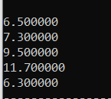
#include <stdio.h>
float array_add(float arr[], int size) ;
int main()
{
float array[5]={1.5, 2.3,4.5,6.7,1.3};
array_add(array, 5);
int i;
for(i=0; i<5; i++)
printf("%f", array[i]);
return 0;
}
float array_add(float arr[], int size)
{
int i;
for(i=0; i<size; i++)
arr[i]=arr[i]+5;
}

Slide 35
#include <stdio.h>
float array_add(float *p, int size) ;
int main()
{
float array[5]={1.5, 2.3,4.5,6.7,1.3};
array_add(array, 5);
int i;
for(i=0; i<5; i++)
printf("%f", array[i]);
return 0;
}
float array_add(float *p, int size)
{
int i;
for(i=0; i<size; i++)
p[i]=p[i]+5; // *p=*p+5; p++;
}

Slide 36
Returning Array Using Pointers
We can return array by returning the address of array first element i.e. array name.
Your array should be static.

Slide 37
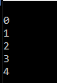
#include <stdio.h>
int * initialize_array(int size);
int main()
{
int *p,i;
p=initialize_array(5);
for(i=0; i<5; i++)
printf("\n%d", *p++);
return 0;
}
int * initialize_array(int size)
{
static int arr[10];
int i;
for(i=0; i<size; i++)
arr[i]=i;
return arr;
}

Slide 38

Passing A 2d array To Function
A two-dimensional array is treated as an array of arrays.
That is, when we access the array using only one subscript, we get a pointer to the corresponding row.

Slide 39
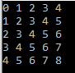
#include <stdio.h>
void initialize_array(int m, int n,int(*arr)[n]);
int main()
{
int m=5, n=5,i,j;
int arr[m][n];
initialize_array(m, n, arr);
for(i=0; i<m; i++)
{
for(j=0; j<n; j++)
printf("%d ", *(*(arr + i) + j));
printf("\n");
}
return 0;}
void initialize_array(int m, int n,int(*arr)[n])
{ int i,j;
for(i=0; i<m; i++)
for(j=0; j<n; j++)
*(*(arr + i) + j) = i + j;
}

Slide 40
Dynamic Memory Allocation

Slide 41
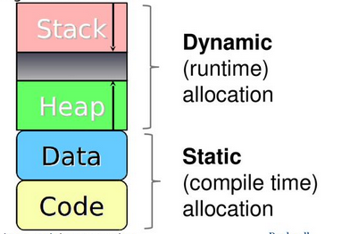
Static Vs Dynamic Memory Allocation
Programmers can dynamically allocate storage space while the program is running, but cannot create new variable names "on the fly".
For this reason, dynamic allocation requires two criteria:
Creating the dynamic space in memory
Storing its address in a pointer (so that space can be accessed)

Slide 42
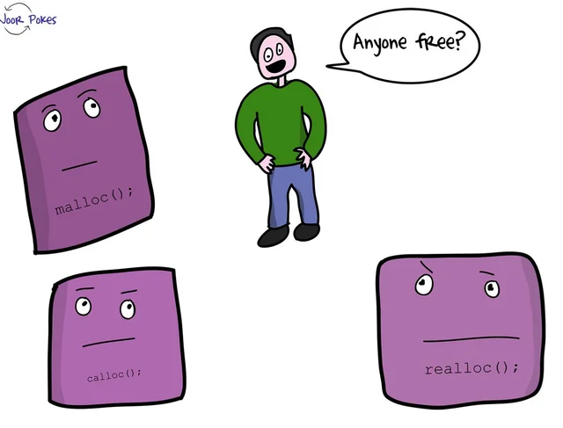
Dynamic Memory Allocation
To allocate memory dynamically, <stdlib.h> has following functions:
malloc()
calloc()
realloc()
free()

Slide 43
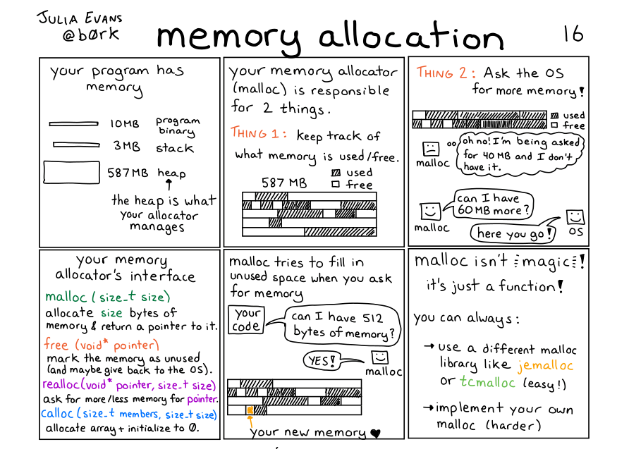

Slide 44
C malloc()
"malloc" stands for memory allocation.
It reserves a block of memory of the specified number of bytes. And, returns a pointer of void which can be type casted in any form.
ptr = (castType*) malloc(size);
ptr = (float*) malloc(100 * sizeof(float)); // 400 bytes reserved

Slide 45
C calloc()
"calloc" stands for contiguous allocation.
It allocates memory and initializes all bits to zero.
ptr = (castType*) calloc(n, size);
ptr = (float*) calloc(100 , sizeof(float));
// 400 consecutive bytes reserved

Slide 46
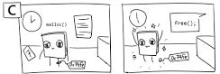
C free()
Dynamically allocated memory created with either calloc() or malloc() doesn't get freed on their own.
You must explicitly use free() to release the space.
free(ptr);

Slide 47
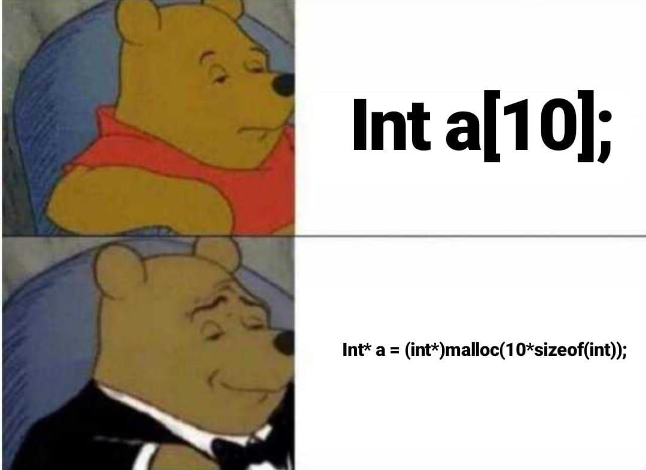
#include <stdio.h>
#include <stdlib.h>
int main()
{
int n,i, *ptr, sum=0;
printf("Enter the number of elements: ");
scanf("%d", &n);
ptr = (int*) malloc(n * sizeof(int));
if(ptr == NULL)
{
printf("Error! Memory not allocated");
return 0; }
printf("Enter elements: ");
for(i = 0; i < n; ++i) {
scanf("%d", ptr+i);
sum += *(ptr + i);
}
printf("Sum = %d", sum);
free(ptr); // deallocating the memory
return 0; }

Slide 48
#include <stdio.h>
#include <stdlib.h>
int main()
{
int n,i, *ptr, sum=0;
printf("Enter the number of elements: ");
scanf("%d", &n);
ptr = (int*) calloc(n , sizeof(int));
if(ptr == NULL)
{
printf("Error! Memory not allocated");
return 0; }
printf("Enter elements: ");
for(i = 0; i < n; ++i) {
scanf("%d", ptr+i);
sum += *(ptr + i);
}
printf("Sum = %d", sum);
free(ptr); // deallocating the memory
return 0; }

Slide 49
C realloc()
If the dynamically allocated memory is insufficient or more than required, you can change the size of previously allocated memory using the realloc() function.
If enough space doesn’t exist in memory of current block to extend, new block is allocated for the full size of reallocation, then copies the existing data to new block and then frees the old block.
ptr = realloc(ptr, size);

Slide 50
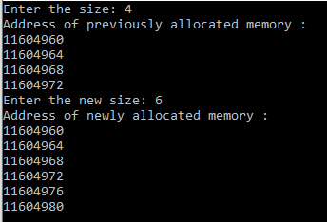
#include <stdio.h>
#include <stdlib.h>
int main()
{
int n1,n2,i, *ptr, sum=0;
printf("Enter the size: ");
scanf("%d", &n1);
ptr = (int*) malloc(n1 * sizeof(int));
printf("Address of previously allocated memory : ");
for(i = 0; i < n1; i++)
printf("%d\n", ptr+i);
printf("Enter the new size: ");
scanf("%d", &n2);
ptr = realloc(ptr, n2 * sizeof(int));// reallocating the memory
printf("Address of newly allocated memory : ");
for(i = 0; i < n2; i++)
printf("%d\n", ptr+i);
free(ptr); // deallocating the memory
return 0;
}

Slide 51
2d Array Using DMA
int *arr = (int*) malloc(m*n * sizeof(int));
To access any element:
*(arr + i*n + j)

Slide 52
#include <stdio.h>
void initialize_array(int m, int n,int(*arr)[n]);
int main()
{
int m=5, n=5,i,j;
int arr[m][n];
initialize_array(m, n, arr);
for(i=0; i<m; i++)
{
for(j=0; j<n; j++)
printf("%d ", *(*(arr + i) + j));
printf("\n");
}
return 0;}
void initialize_array(int m, int n,int(*arr)[n])
{ int i,j;
for(i=0; i<m; i++)
for(j=0; j<n; j++)
*(*(arr + i) + j) = i + j;
}

Slide 53
#include <stdio.h>
#include <stdlib.h>
void initialize_array(int m, int n,int *arr)
{ int i,j;
for(i=0; i<m; i++)
for(j=0; j<n; j++)
*(arr + i*n + j) = i + j; }
int main()
{
int m=5, n=5,i,j;
int *arr = (int*) malloc(m*n * sizeof(int));
initialize_array(m, n, arr);
for(i=0; i<m; i++)
{
for(j=0; j<n; j++)
printf("%d ", *(arr + i*n + j));
printf("\n");
}
free(arrr); // deallocating the memory
return 0;}

Slide 54
More Pointers :(

Slide 55

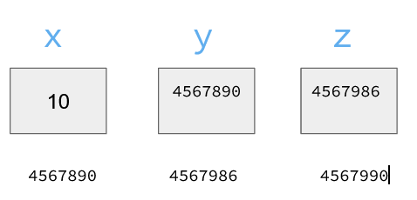
Double Pointer
Double Pointer is a pointer to pointer.
int x = 10;
int *y = &x;
int **z = &y;
printf("%d %d %d\n", x, *y, **z);

Slide 56
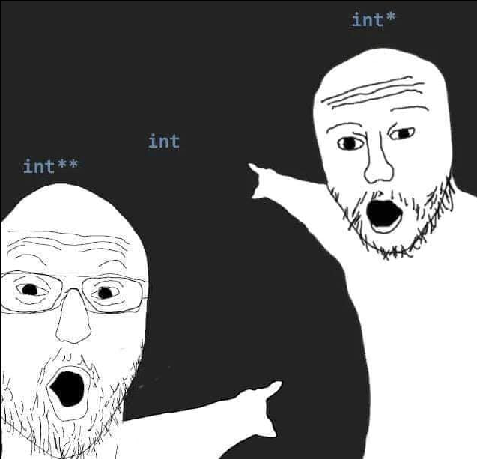
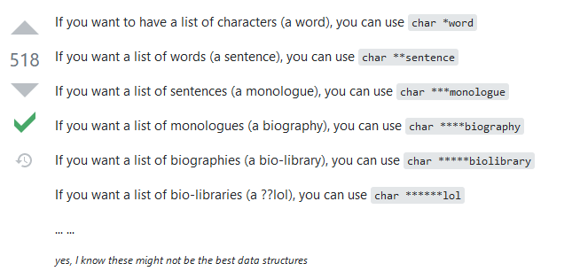
Why Use Double Pointers

Slide 57
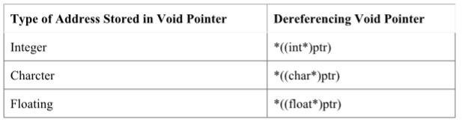
VOID Pointer
It is a general purpose pointer.
A pointer that has no associated data type with it.
It holds address of any type and can be typcasted to any type.

Slide 58
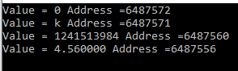
#include <stdio.h>
int main()
{
int a=0;
char b='k';
double c=345678666;
float d=4.56;
void *ptr=NULL;
ptr = &a;
printf("Value = %d Address =%d\n", *(int *)ptr, ptr);
ptr = &b;
printf("Value = %c Address =%d\n", *(char *)ptr, ptr);
ptr = &c;
printf("Value = %ld Address =%d\n", *(double *)ptr, ptr);
ptr = &d;
printf("Value = %f Address =%d\n", *(float *)ptr, ptr);
return 0;
}

Slide 59
Casting Pointer
When assigning a memory address of a variable of one type to a pointer that points to another type it is best to use the cast operator to indicate the cast is intentional (this will remove the warning).
int V = 101;
float *P = (float *) &V; /* Casts int address to float * */
Removes warning, but is still a somewhat unsafe thing to do.

Slide 60
Constant Pointer
It is a pointer that cannot change the address its holding.
Once a constant pointer points to a variable then it cannot point to any other variable.
int * const ptr;

Slide 61
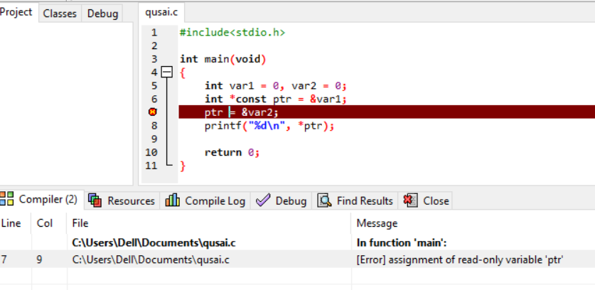
Constant Pointer
It is a pointer that cannot change the address its holding.
Once a constant pointer points to a variable then it cannot point to any other variable.
int * const ptr;

Slide 62
Pointer To Constant
A pointer through which one cannot change the value of variable it points is known as a pointer to constant.
These type of pointers can change the address they point to but cannot change the value kept at those address.
const int * ptr;

Slide 63
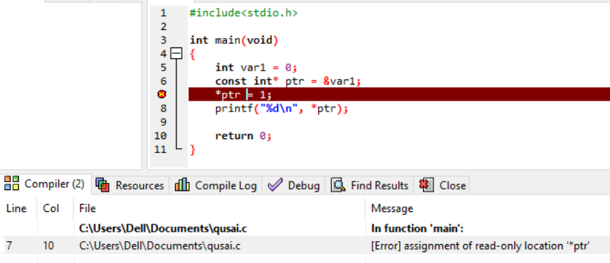
Pointer To Constant

Slide 64
#include <stdio.h>
int cube(const int *x,int *a);
int main()
{
int num=4, result=0;
cube(&num, &result);
printf("%d", num);
return 0;
}
int cube(const int *x,int *a)
{
*a= (*x) * (*x) *(*x); // This is correct
//*x= (*x) * (*x) *(*x); This is wrong
}

Slide 65
Constant Pointer To Constant
A constant pointer to constant is a pointer that can neither change the address its pointing to and nor it can change the value kept at that address.
const int * const ptr;

Slide 66
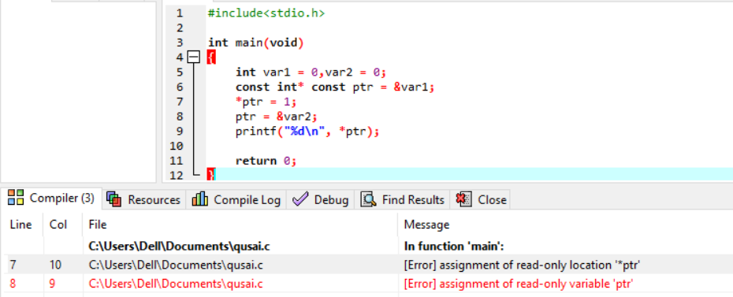
Constant Pointer To Constant

Slide 67
Function Pointer
A pointer which keeps address of a function is known as
function pointer.
void *(*ptr)();
We are simply declaring a double pointer.
Write () symbol after “Double Pointer“.
void represents that, function is not returning any value.
() represents that, function is not taking any parameter.

Slide 68
Function Pointer
ptr = &display; // initializing the pointer
(*ptr)(); // calling a function
(*ptr)() = (*ptr)();
= (*&display)();
= (display)();
= display();

Slide 69
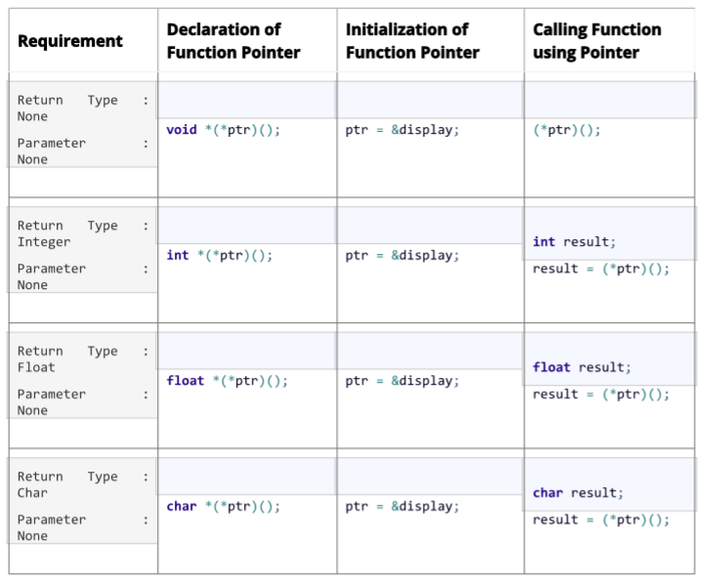

Slide 70
#include <stdio.h>
void smile(); // Function Declaration or Prototype
int main()
{
void *(*ptr)();
ptr = &smile; // Initializing the pointer
(*ptr)(); // Function Call
return 0;
}
void smile() // Function Definition
{
printf("\nSmile, and the world smiles with you...");
}

Slide 71
Function Prototype
#include<stdio.h>
char * getName(int *,float *);

Slide 72
Function Definition
char *getName(int *ivar,float *fvar)
{
char *str="www.nu.edu.pk";
return(str);
}

Slide 73
Main
int main()
{
char *name; int num = 100; float marks = 99.12;
char *(*ptr)(int*,float *);
ptr=&getName;
name = (*ptr)(&num,&marks);
printf("Name : %s",name);
return 0;
}

Slide 74
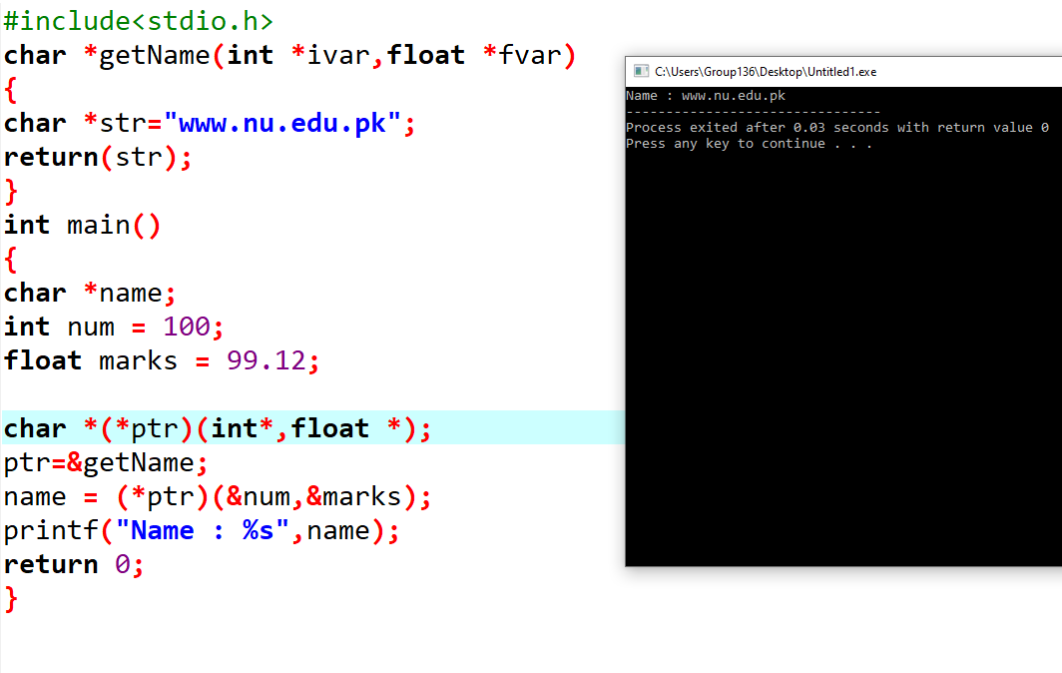

Slide 75
Structures & Pointers

Slide 76
Struct pointer
struct student {
char name[20]; float marks;int batch; char city; int roll_num; };
struct student *ptr, student1;
ptr=&student1;
(*ptr).batch= ptr->batch
-> member access operator for pointers

Slide 77
#include <stdio.h>
struct student
{
char name[20]; float marks; int batch; char city; int roll_num;
};
int main()
{
struct student student1, *ptr;
ptr=&student1;
printf("Enter your name :"); scanf("%s", ptr->name);
printf("Enter your marks:"); scanf("%f", &ptr->marks);
printf("Enter your batch:"); scanf("%d", &ptr->batch);
printf("Enter your city:"); scanf(" %c",&ptr->city);
printf("Enter your roll_num:"); scanf("%d", &ptr->roll_num);
printf("Your data is\nName : %s \nMarks : %f\nBatch : %d\nCity:%c\nRoll Number :%d", ptr->name, ptr->marks, ptr->batch, ptr->city, ptr->roll_num);
return 0;
}

Slide 78
DMA of Struct
Sometimes, the number of struct variables you declared may be insufficient.
You may need to allocate memory during run-time.

Slide 79
#include <stdio.h>
#include <stdlib.h>
struct student
{
char name[20]; float marks; int batch; char city; int roll_num;
};
int main()
{
struct student *ptr; int i,n;
printf("Enter the number of students: ");
scanf("%d", &n);
ptr = (struct student *) malloc(n * sizeof(struct student));
for(i=0; i<n; i++)
{
printf("Enter your name :"); scanf("%s", (ptr+i)->name);
printf("Enter your marks:"); scanf("%f", &(ptr+i)->marks);
printf("Enter your batch:"); scanf("%d", &(ptr+i)->batch);
}
free(ptr); // deallocating the memory
return 0;}

Slide 80
Thank You

